Slide 1
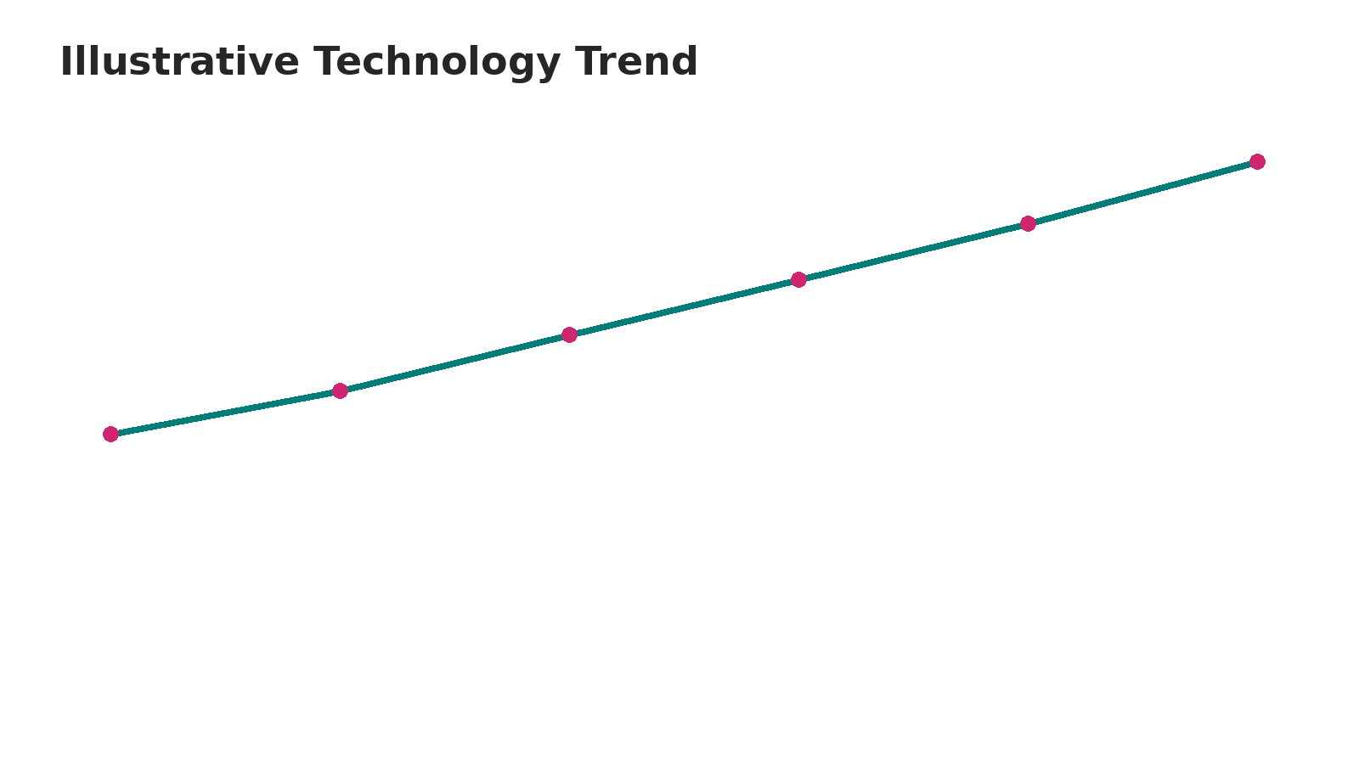
Capstone Story
Technology Skills, Job Market & Data Insights
Capstone Story • Data Analytics Project • Slide 1

Slide 2
EXECUTIVE SUMMARY
This capstone analyzes technology skills, programming-language demand, databases, and job-market indicators.
Data is collected, cleaned, explored, visualized, queried, and interpreted to identify practical technology trends.
The presentation combines descriptive analytics, SQL exploration, geographic visualization, dashboards, and predictive analysis.
Key insight: demand is increasingly shaped by transferable skills across programming, data, cloud, and database technologies.
Capstone Story • Data Analytics Project • Slide 2

Slide 3
INTRODUCTION
Problem: technology roles change quickly, making it difficult to identify which skills and tools remain valuable.
Goal: transform job and technology data into clear evidence that supports learning and career decisions.
Questions: Which technologies appear most often? Which skills show stronger demand? What patterns appear across locations and categories?
Audience: learners, career changers, recruiters, educators, and technology professionals.
Capstone Story • Data Analytics Project • Slide 3

Slide 4
DATA COLLECTION & DATA WRANGLING METHODOLOGY
Collected job-posting information through a Job API and web-scraping workflow.
Worked with the project files job-postings.xlsx and popular-languages.csv referenced by the provided template.
Wrangled data by inspecting columns, standardizing text fields, handling missing values, removing duplicates, and preparing analytical categories.
Prepared clean datasets for visualization, SQL analysis, dashboards, and predictive modeling.
Capstone Story • Data Analytics Project • Slide 4

Slide 5
EDA & DATA VISUALIZATION METHODOLOGY
Exploratory Data Analysis (EDA) was used to identify distributions, rankings, relationships, and unusual observations.
Bar charts compare technology frequency and salary-related measures; trend charts show change over time.
Visual design emphasizes readable labels, descending rankings, clear titles, and direct interpretation.
Visualizations are used as evidence for findings rather than decoration.
Capstone Story • Data Analytics Project • Slide 5

Slide 6
PREDICTIVE ANALYSIS — CLASSIFICATION
Objective: classify records into meaningful technology/job categories using available features.
Workflow: prepare features → split data → train classification model → evaluate predictions → interpret important factors.
Evaluation should consider accuracy alongside class-level performance so that imbalanced categories are not hidden.
The model supports decision-making by estimating likely categories from observed job characteristics.
Capstone Story • Data Analytics Project • Slide 6

Slide 7
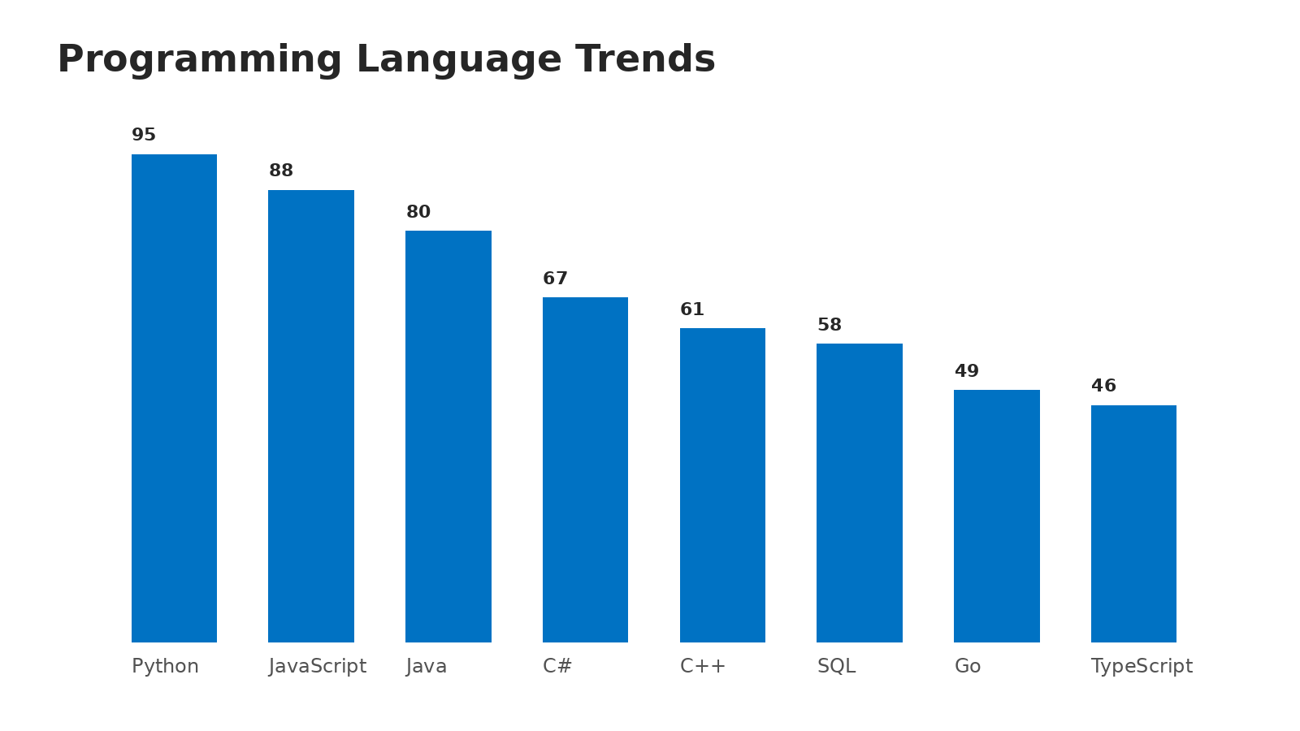
EDA WITH VISUALIZATION
Programming-language demand can be compared using ranked frequency measures.
The visual makes relative popularity easier to compare than a raw table.
Use the completed notebook output when submitting the final evidence.
Capstone Story • Data Analytics Project • Slide 7

Slide 8
EDA WITH SQL — SLIDES / QUERIES
SQL exploration focuses on filtering, grouping, aggregation, sorting, and ranking technology records.
Example query pattern: SELECT technology, COUNT(*) AS postings FROM jobs GROUP BY technology ORDER BY postings DESC;
Additional analysis can calculate average salary by technology and compare job counts by location.
SQL results should be cross-checked against visualizations to validate analytical conclusions.
Capstone Story • Data Analytics Project • Slide 8

Slide 9
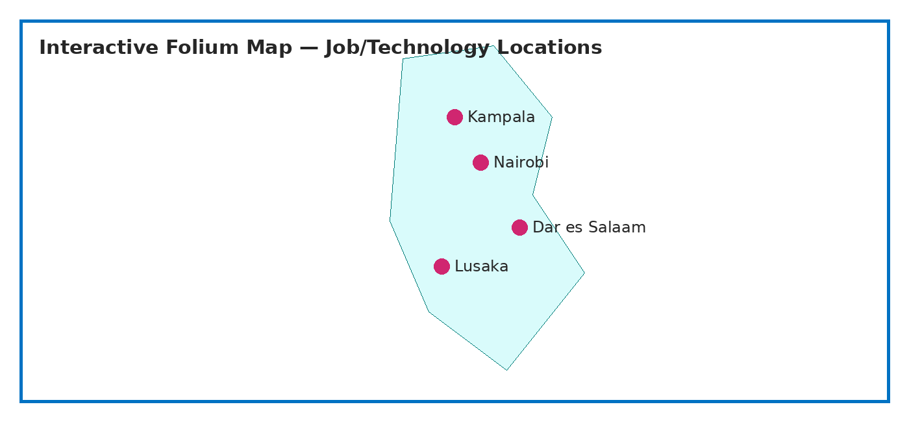
FOLIUM MAP — GEOGRAPHIC ANALYSIS
Map-based analysis adds geographic context to job-market observations.
Markers can represent posting locations, technology demand, or aggregated categories.
The final submission should include the interactive Folium output or a clear screenshot from the completed notebook.
Capstone Story • Data Analytics Project • Slide 9

Slide 10
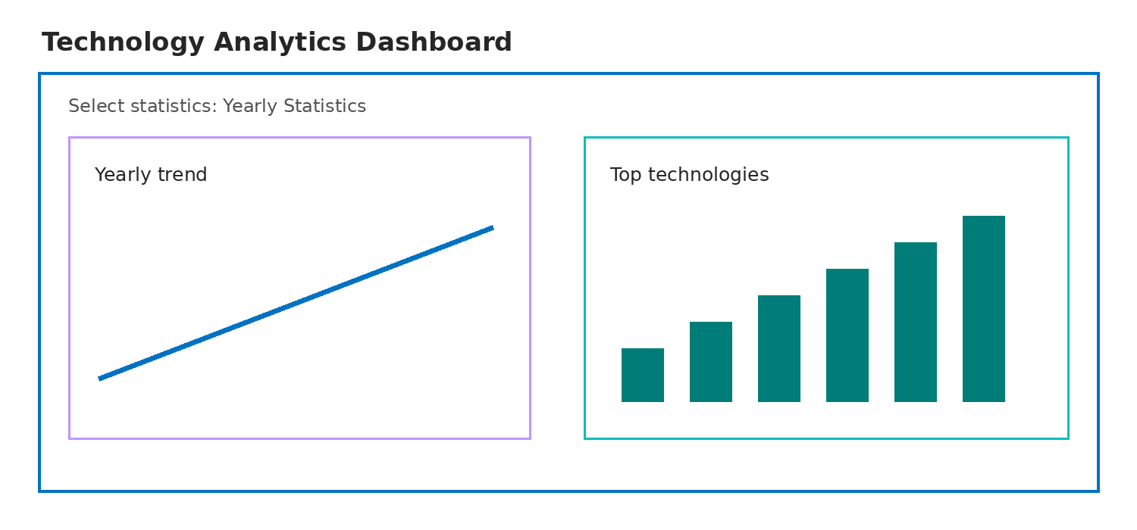
PLOTLY DASH — INTERACTIVE DASHBOARD
Capstone Story • Data Analytics Project • Slide 10

Slide 11
DASHBOARD
GitHub repository URL: [INSERT YOUR ACTUAL GITHUB REPOSITORY URL HERE]
Repository should contain the completed notebooks, Python files, datasets where permitted, and dashboard code.
The final PDF should include screenshots of the completed dashboard tabs and describe what each view demonstrates.
Do not submit a placeholder-only dashboard slide.
Capstone Story • Data Analytics Project • Slide 11

Slide 12
DASHBOARD TAB 1 — OVERVIEW
Screenshot/evidence of the completed interactive dashboard view.
Include the selected controls, visible charts, and a short interpretation of the displayed results.
Capstone Story • Data Analytics Project • Slide 12

Slide 13
DASHBOARD TAB 2 — TRENDS
Screenshot/evidence of the completed interactive dashboard view.
Include the selected controls, visible charts, and a short interpretation of the displayed results.
Capstone Story • Data Analytics Project • Slide 13

Slide 14
DASHBOARD TAB 3 — DETAIL
Screenshot/evidence of the completed interactive dashboard view.
Include the selected controls, visible charts, and a short interpretation of the displayed results.
Capstone Story • Data Analytics Project • Slide 14

Slide 15
DISCUSSION
The combined analyses show that technology demand is multi-dimensional: frequency, salary, location, and technology combinations all matter.
No single metric should be treated as a complete measure of career value.
Interactive dashboards and maps make it easier to move from broad trends to specific questions.
Predictive analysis complements descriptive analysis by estimating likely categories from observed patterns.
Capstone Story • Data Analytics Project • Slide 15

Slide 16
OVERALL FINDINGS & IMPLICATIONS
Finding 1: programming and data skills recur across multiple technology categories.
Finding 2: database and cloud-related skills are important complements to programming ability.
Finding 3: job-market patterns vary by technology and geography, so local context matters.
Implication 1: learners should build a stack of complementary skills rather than focus on one tool.
Implication 2: dashboards can support continuous monitoring of changing technology demand.
Implication 3: evidence-based skill planning is stronger than relying on isolated popularity rankings.
Capstone Story • Data Analytics Project • Slide 16

Slide 17
CONCLUSION
The capstone demonstrates an end-to-end analytics workflow from data collection and wrangling to visualization, SQL, mapping, dashboards, and prediction.
The project converts technology/job data into practical insights for skills planning and career decisions.
The strongest submission evidence is the completed notebooks, Python files, repository URL, dashboard screenshots, and final PDF.
Future work: refresh the datasets regularly, expand geographic coverage, and compare predictive models.
Capstone Story • Data Analytics Project • Slide 17

Slide 18
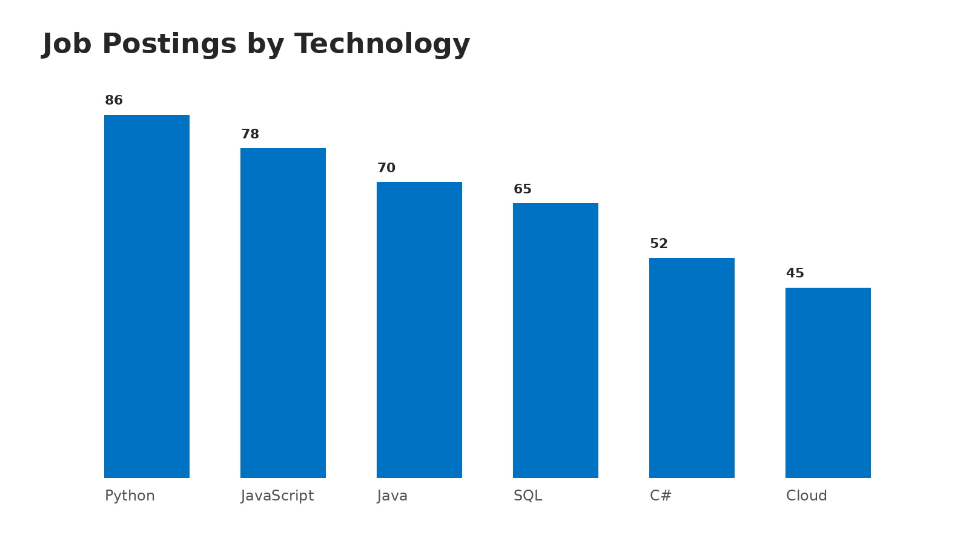
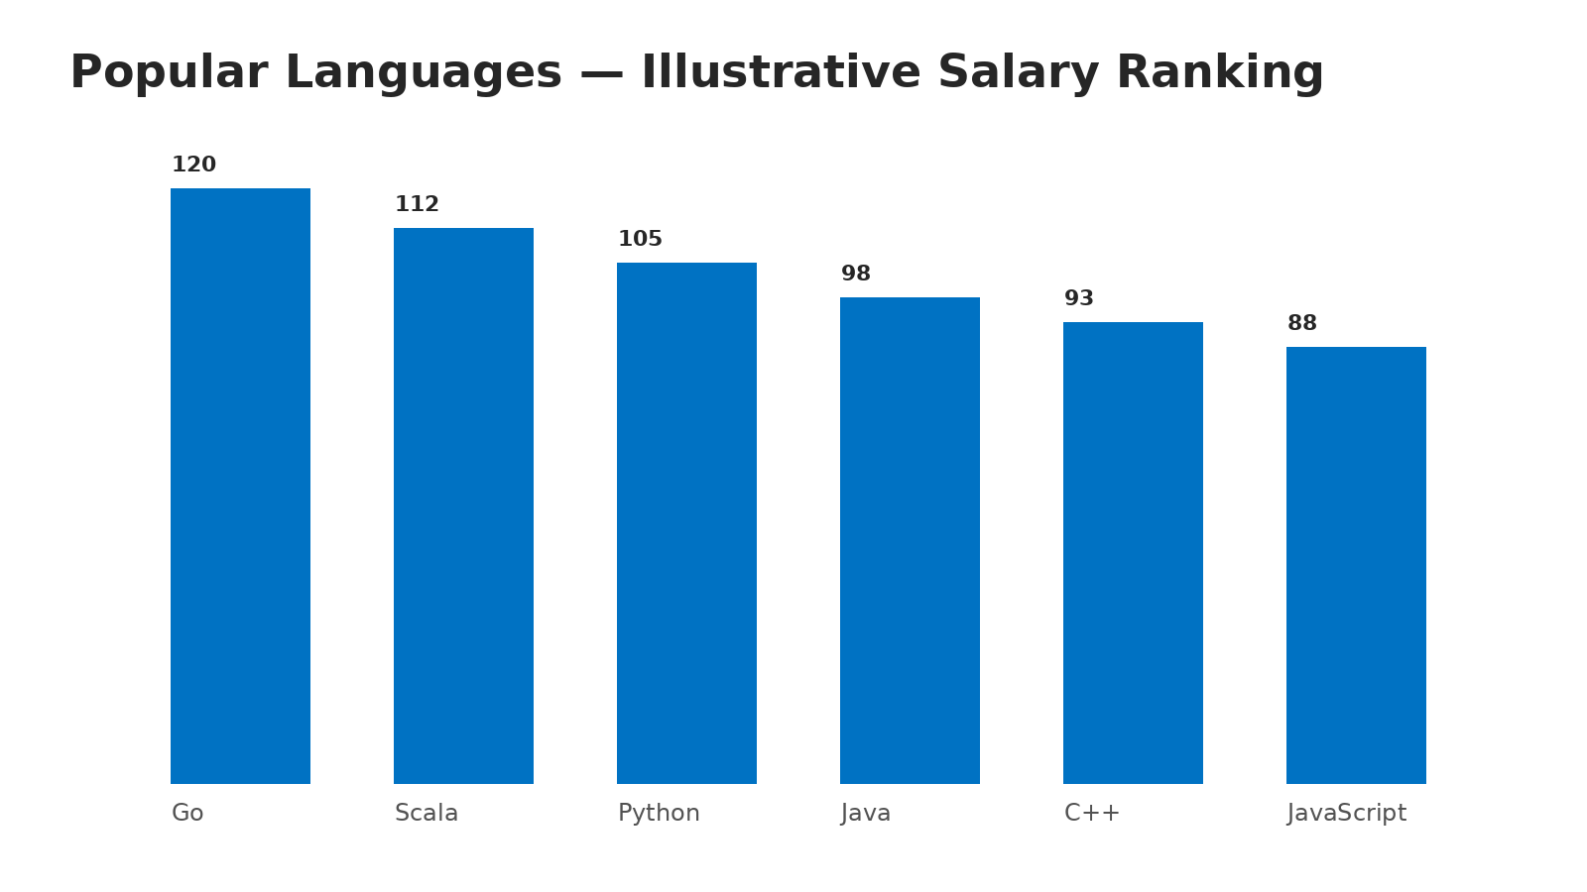
APPENDIX
Job postings: present the completed API data in descending order of posting count.
Popular languages: present the completed scraped data in descending order of salary.
Capstone Story • Data Analytics Project • Slide 18

